Slide 1
Eclipse Plug-in Development
Eclipse Plug-in Development Part 6
Feature and Fragment Projects

Slide 2
Contents
Features
Feature Project
Deploy
Fragments
Fragment Project
Update Site
Update Site Project
Build
Install

Slide 3
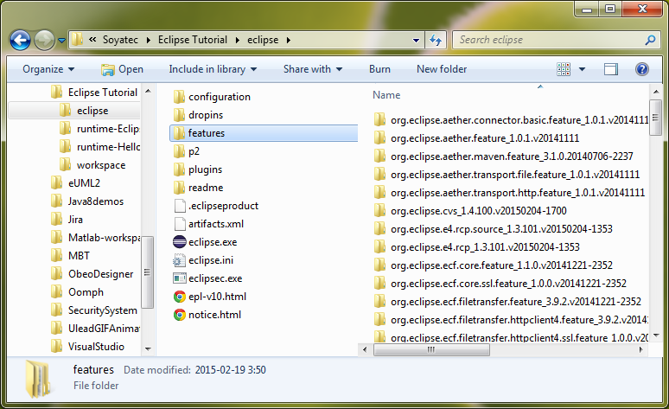
Features

Slide 4
Features
feature.xml
description
copyright
license
plugins
features
<?xml version="1.0" encoding="UTF-8"?>
<feature
id="org.ecsoya.eclipse.tutorial.feature"
label="Feature Tutorial"
version="1.0.0.qualifier"
provider-name="Ecsoya">
<description url="http://www.example.com/description">
[Enter Feature Description here.]
</description>
<copyright url="http://www.example.com/copyright">
[Enter Copyright Description here.]
</copyright>
<license url="http://www.example.com/license">
[Enter License Description here.]
</license>
<plugin
id="org.ecsoya.eclipse.tutorial"
download-size="0"
install-size="0"
version="0.0.0"
unpack="false"/>
</feature>

Slide 5
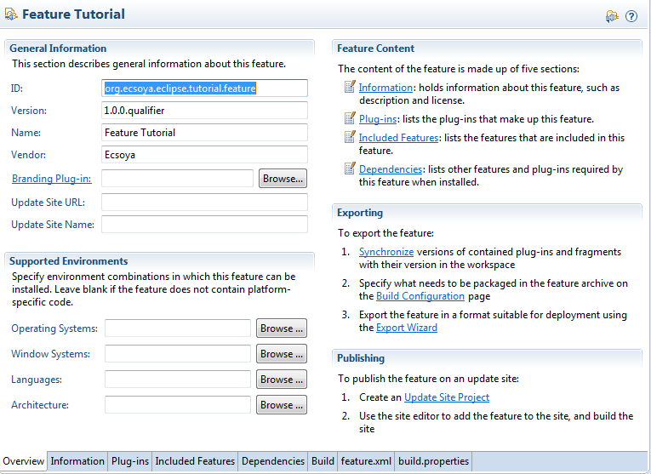
Features
Feature Project

Slide 6
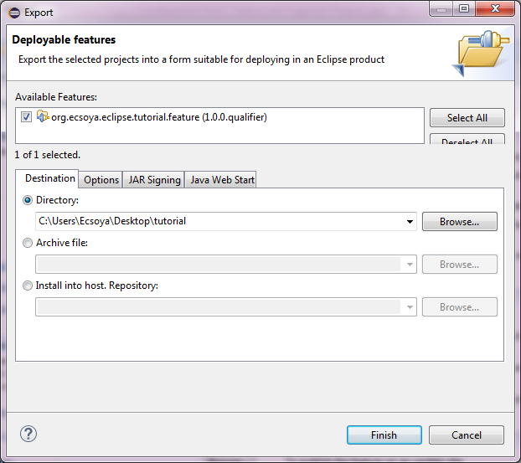
Features
Deploy

Slide 7
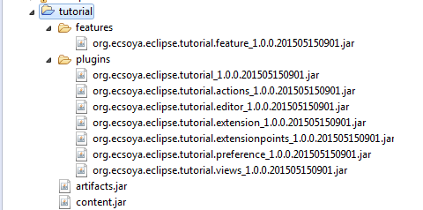
Features
Deploy

Slide 8
Fragments
What are fragments in OSGi?
Optional attachment to another plug-in (host plug-in)
Typical use cases for fragments
Contain test cases for internal API of host plug-in
New language support with translating “*.properties” files
Supply native code which is specific to a certain system environment

Slide 9
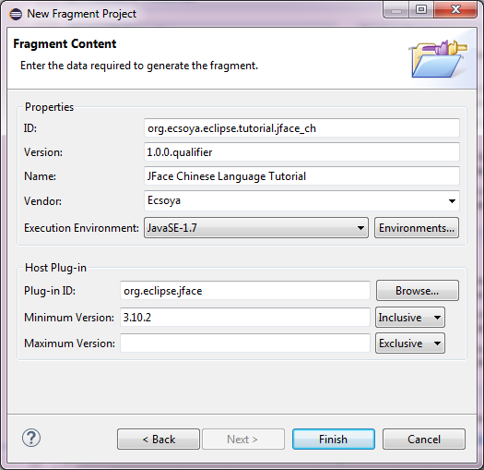
Fragments
Fragment Project

Slide 10
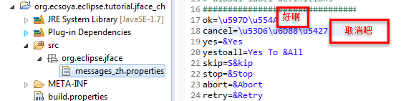
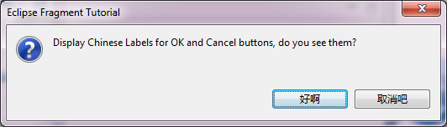
Fragments
Fragment Project

Slide 11
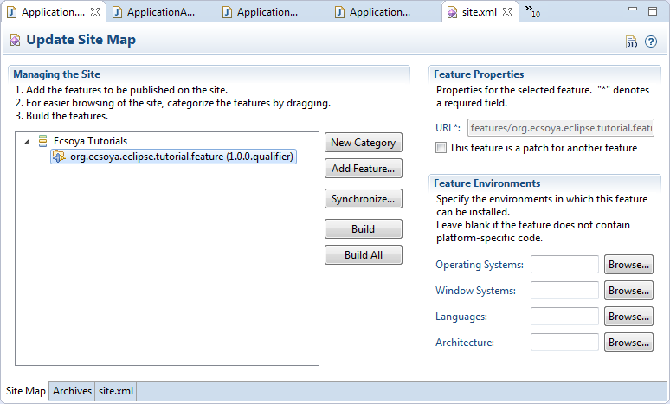
Update Site

Slide 12
Update Site
Update Site Project
site.xml
<?xml version="1.0" encoding="UTF-8"?>
<site>
<feature url="features/org.ecsoya.eclipse.tutorial.feature_1.0.0.qualifier.jar"
id="org.ecsoya.eclipse.tutorial.feature" version="1.0.0.qualifier">
<category name="Ecsoya Tutorials"/>
</feature>
<category-def name="Ecsoya Tutorials" label="Ecsoya Tutorials"/>
</site>

Slide 13
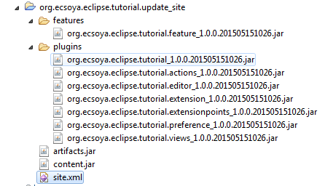
Update Site
Build

Slide 14
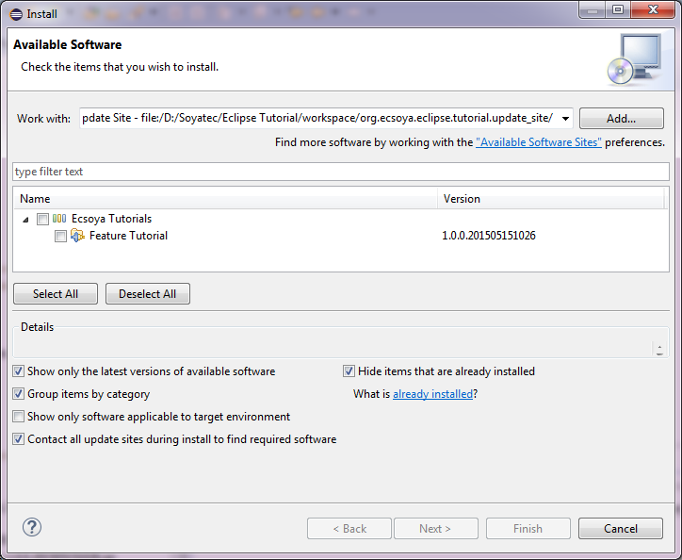
Update Site
Install

Slide 15
Any Questions?
Skype: jin.liu.soyatec
Email: jin.liu@soyatec.com

Slide 16
The end

